Slide 1
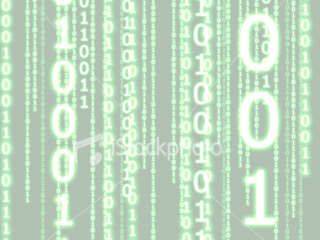
PRELIM

Slide 2
Personal Computers
What are Personal Computers?
Personal computers are integrated circuit that contains the arithmetic logic unit (ALU) and the unit of computer central processing unit (CPU).

Slide 3
COMPUTER SYSTEMS
System - is an organized group of related and interdependent elements, parts, or components interacting in performing the individual and specific tasks for the purpose of meeting one or more goals and objectives.
Components of a Computer System
Hardware
Software
People ware
Data ware

Slide 4
Hardware
is the physical components of the computer system whether internal or external that are tangible in nature.
Components of the internal hardware
CPU
- this is known as the processor.
Parts of CPU
a. Control unit(CU) - Interprets program instructions and directs the other parts of the CPU, and communicates with the external input/output devices and secondary storage media
b. Arithmetic logic(ALU) – it does all the calculation, comparison or logical operation, s directed by the CU.

Slide 5
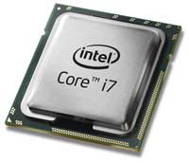
Hardware
CPU – Central Processing Unit

Slide 6
Hardware
Components of the internal hardware
2. Memory
- It stores data and instructions before the execution and the processed data as well
Types of Memory
Internal Memory
    Random-Access Memory (RAM) – It is a volatile type of memory
- refers to as Main Memory or Primary Memory
    Read-Only Memory (ROM) – contains permanently stored instructions that cannot be changed.
External Memory
    Secondary Memory - Also known as Auxiliary Memory.
- It is a non-volatile type of memory that is responsible foe keeping files permanently.

Slide 7
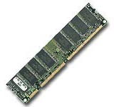
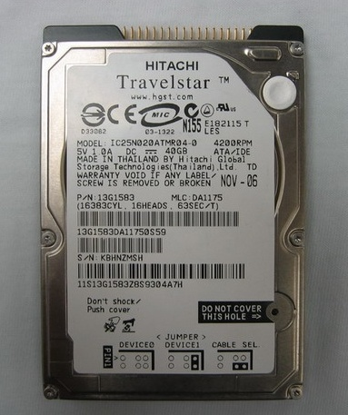
Hardware
Memory

Slide 8
Hardware
Components of the internal hardware
3. Input and Output Unit
it allows communication between the computer and its outside world via input and output devices.
Other parts that go along with the Processor:
Bus - It is an electronic circuit that sends data and messages between the other components.
Ports - It attach input and output devices to the computer.
Expansion slots - It allow the addition of extra features.
Registers - Are special temporary storage which quickly accepts, stores, and transfers data and instructions for immediate use.

Slide 9
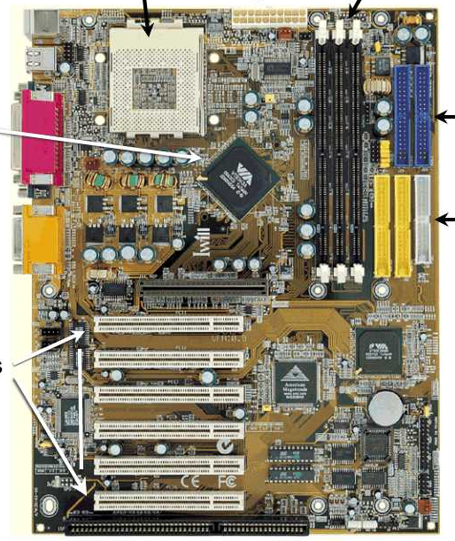
Hardware
Motherboard

Slide 10
Hardware
Components of the external hardware
Input hardware
Processing hardware
Storage hardware
Output hardware
Communication hardware

Slide 11
Hardware
Components of the external hardware
Input Hardware
- it accept or collect data and convert it into a form suitable for processing.
TYPES
  Keyboard- Entry Devices
    Keyboards. It is the most commonly used input device.
    Terminals. It consists of keyboard, video display screen and a communication line to a mainframe computer.
THREE TYPES OF TERMINAL
      Dumb – can be used only to input data to and receive information from a computer system.
      Smart – can do input and output and has some limited processing capability.
      Intelligent – a full fledge microcomputer with a communication link.

Slide 12
Hardware
Components of the external hardware
Input Hardware
TYPES
  Direct-Entry Devices
    Pointing Devices
        Mouse – a pointing device that allows you to control an on-screen cursor.
        Trackball – the upside-down version of the mouse. A ball mounted in box is rolled with the fingers to move the cursor.
        Joystick – a video display screen that picks up input from the user through the touch of a finger.
        Light pen –it is a point and draw input device that allows you to draw directly on screen.
        Digitizing tablet – a pen-like device with which the user “sketches” an image or puck
        Pen based systems – a pen like stylus to enter handwriting and marks into a computer.

Slide 13
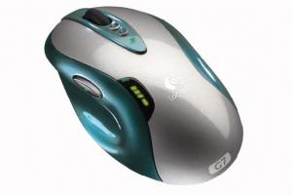
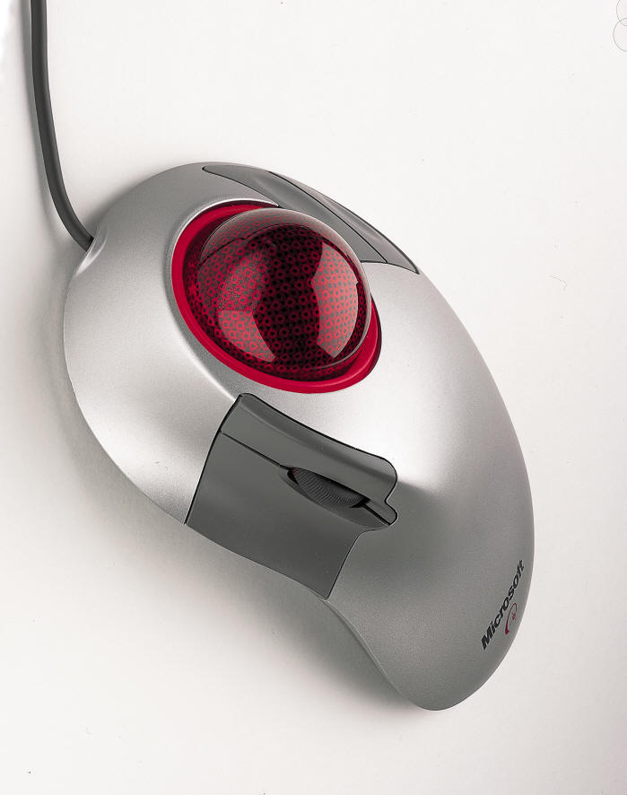
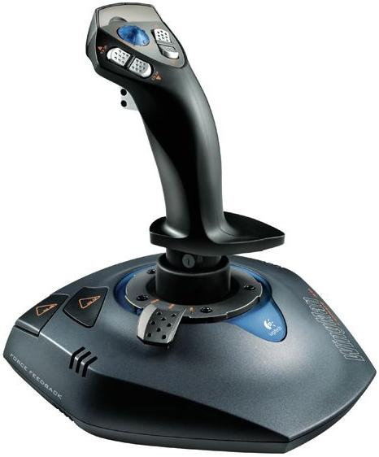
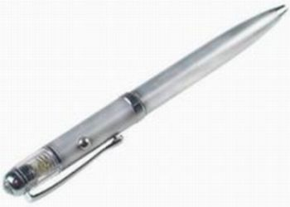
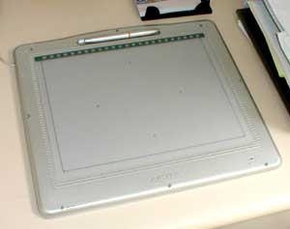
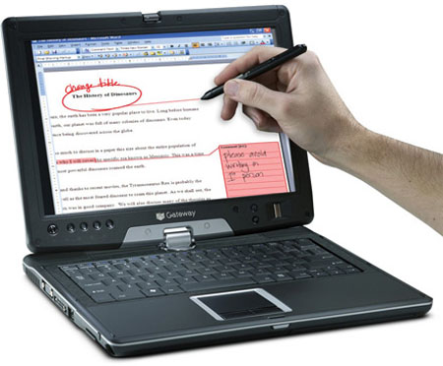
Hardware
JOYSTICK
MOUSE
TRACKBALL
LIGHT PEN
DIGITIZING TABLET
PEN BASED SYSTEM

Slide 14
Hardware
Components of the external hardware
Input Hardware
TYPES
  Scanning Device - It translates images of text, drawing, and photos and the like into forms of data that can be understood by the computer.
    Bar code readers – photoelectric scanner that translate the bar code symbols into digital forms.
    Mark and Character recognitions devices
MICR (Magnetic-Ink Character Recognition) – it reads the strange-looking numbers printed at the bottom of bank checks
      OMR (Optical Mark Recognition) – it reads pencil marks
      OCR(Optical Character Recognition) – it reads special preprinted characters

Slide 15
Hardware
Components of the external hardware
Input Hardware
    Fax Machine (Facsimile Transmission Machine) – it scans an image and sends it as an electronic signals over telephone lines
    Imaging Systems/Image Scanner/ Graphics Scanner – it converts text, drawings, and photographs into forms
    Smart Cards and Optical cards
      Smart cards – it contain a microprocessor and a memory chip.
      Optical Cards – it s a plastic, laser-recordable card used with an optical card reader.

Slide 16
Hardware
Components of the external hardware
Input Hardware
    Other Devices
      Voice Recognition Systems – they convert human speech into digital code.
      Audio- Input Device – they record or play analog sounds
      Video- Input Devices – signals that come from VCR o r a camera recorder
      Electronic cameras – they capture images in electronic form
Sensors – it collects specific kinds of data directly from the environment

Slide 17
Hardware
Components of the external hardware
Processing Hardware
- It is used to retrieve and execute the instructions provided by the computer
Main Components
    CPU
    Main Memory
  System Unit –it contains electrical components that make the computer
works.
    Power supply – is a device that converts AC to DC power to run the computer.
    Motherboard – it is the main circuit board in the system unit.
    CPU – the microprocessor chip.
    Specialized Processor chips – used to speed up your computer system
    System clock – it controls how fast all operations within a computer are performed.

Slide 18
Hardware
Components of the external hardware
Processing Hardware
System Unit (continue)
  RAM chips - chips that temporarily hold data and instructions
  ROM chips – chips containing programs that are built into the computer
  Cache memory – is the special high-speed memory that the CPU can access quickly.
  Expansion slots and boards- are sockets on the motherboard into which you can plug expansion cards or boards.
  Bus line – the electrical pathways through which nits are transmitted within the CPU and between the CPU and other devices in the system unit.
  Port – the sockets on the outside of the system unit that each connected to an expansion board on the inside of the system unit.
  PCMICIA slots and cards – it represents a new bus standard for notebooks, subnotebooks and pocket computers.

Slide 19
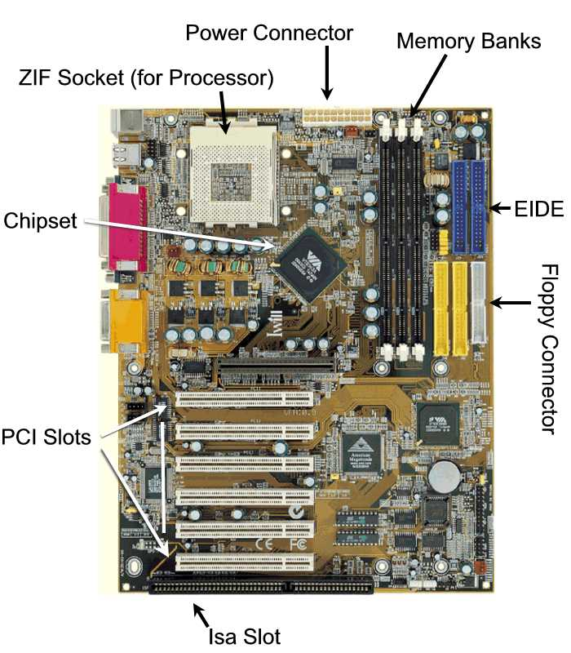

Slide 20
Hardware
Components of the external hardware
Storage Hardware. It temporarily or permanently store data used for processing and the output of such processing.
Two types:
  Primary Storage – refers to main memory (RAM).
  Secondary Storage- refers to storage devices that retain data and instruction in a relatively permanent (non-volatile) form.
    Diskettes
    Hard disks
    Optical storage – use a laser beam to pack information densely on are movable disk
    Magnetic tapes – a sequential file storage represented by various arrangements of magnetized spots along the width of the tape
    Magnetic disk – a metal plotter where data is represented by magnetized spots on the tracks.

Slide 21
Hardware
Components of the external hardware
Storage (continue)
    Magnetic strip – a recording of a data cell device capable of storing 400 million of data
    Paper tape – a continuous strip of paper wound on a reel where data is represented by holes punched on the paper.
    Drum – a recording medium of data represented by magnetized spots that is coated with a magnetically sensitive material divided into tracks.
    Continuous forms – a long sheets of paper where data is represented thru print out.
    Computer Output Microfilm (COM)- stores large volume of information printed or photographed as a very small images on sheets or roll of film called Microfiche.

Slide 22
Hardware
Components of the external hardware
Output Hardware - It provide a means for the user to view information produced by the computer system.
Two forms:
    Hardcopy – it is when an information has been recorded in a tangible medium, such as paper or microfilm
    Softcopy – it is when an output is temporarily displayed on the screen
Hardcopy Output Hardware:
    Printer – it is capable of printing characters, symbols and graphics.
Categories:
    Impact printer – it has contact with papers like daisy wheel printers, dot-matrix printers and line printers
    Non-impact printers –it has no contact with the paper like laser printer, ink-jet printers and thermal printers.

Slide 23
Hardware
Components of the external hardware
Output Hardware (continue)
Hardcopy Output Hardware:
  Plotter – they are specialized output devices that can produce high quality graphics in a variety of colors.
3 types:
    Pen plotter – the most popular type of plotter
    Electrostatic plotter – electrostatic charges create tiny dots on specially treated paper.
    Thermal plotter – its pins are electronically heated and are used with heat-sensitive paper to produce images.
Softcopy Output Hardware:
  Cathode Ray Tube (CRT) – the most popular softcopy output device used on microcomputers
  Flat Panel Displays – they are used with portable computers.

Slide 24
Hardware
Components of the external hardware
Communication Hardware
It facilitate the connection between computers connected with a network of computers over phone lines and other channels.
Includes:
Modems - it converts digital signals to analog signals.
Cable – commonly used in networking, to facilitate the communication between those computers.
Fax modems – a modem with fax capability installed as a circuit board in the motherboard of a computer
Multiplexers – it combines several low-speed transmission into one high-speed transmission.
Concentrator- it collects data in a temporary storage area, then send it forward when enough has been accumulated.
Front-end Processor- a computer that handles communications for mainframes.

Slide 25
Software
Categories of Software
1. System software- facilitating applications programs.
Types of system software
a. operating system - refers to a group of related programs that supervise the execution of an application program
b. operating environment - refers to programs that sit on top of OS
c. utilities - a single term for all types of programming aids
d. programming languages- the programs used to write other programs
e. language processor - used to convert source program into a form suitable for execution
      compliers
      assemblers
      interpreters

Slide 26



Software
Categories of Software
2. Application software- use program designed to solve problem.
Types of application software
Package program
commonly called application package.
Custom program
- specifically written for an organization.
Types of Package Programs
Levels of programming languages
1. Machine language
2. Symbolic language
3. High level language

Slide 27


Peopleware
refers to the personnel involved in data processing operations
Functional Areas of Peopleware:
  Systems Programming
  System analysts
  Application programming
  Computer Operations
Personnel:
  Data Entry Operator
  Computer Operator
  Computer Programmer
  System Analysts
  Computer Center Director

Slide 28

Dataware
refers to rules and policies that govern the operations of the whole computer system
Examples of Dataware:
  Instruction Manuals
  Operating Procedures
  Processing Procedures
  Recipe Cooking

